Slide 1

Description Regarding the Eye Diseases Detection using ML
Student1:prajwol giri
Student2:sagar kumar shah
Student3:rajan yadav
Student4:aman kumar
Under the guidance of
ravi lankhe

Slide 2

Content
Introduction
Literature Survey
Methodology
Experiments and results
Conclusion

Slide 3
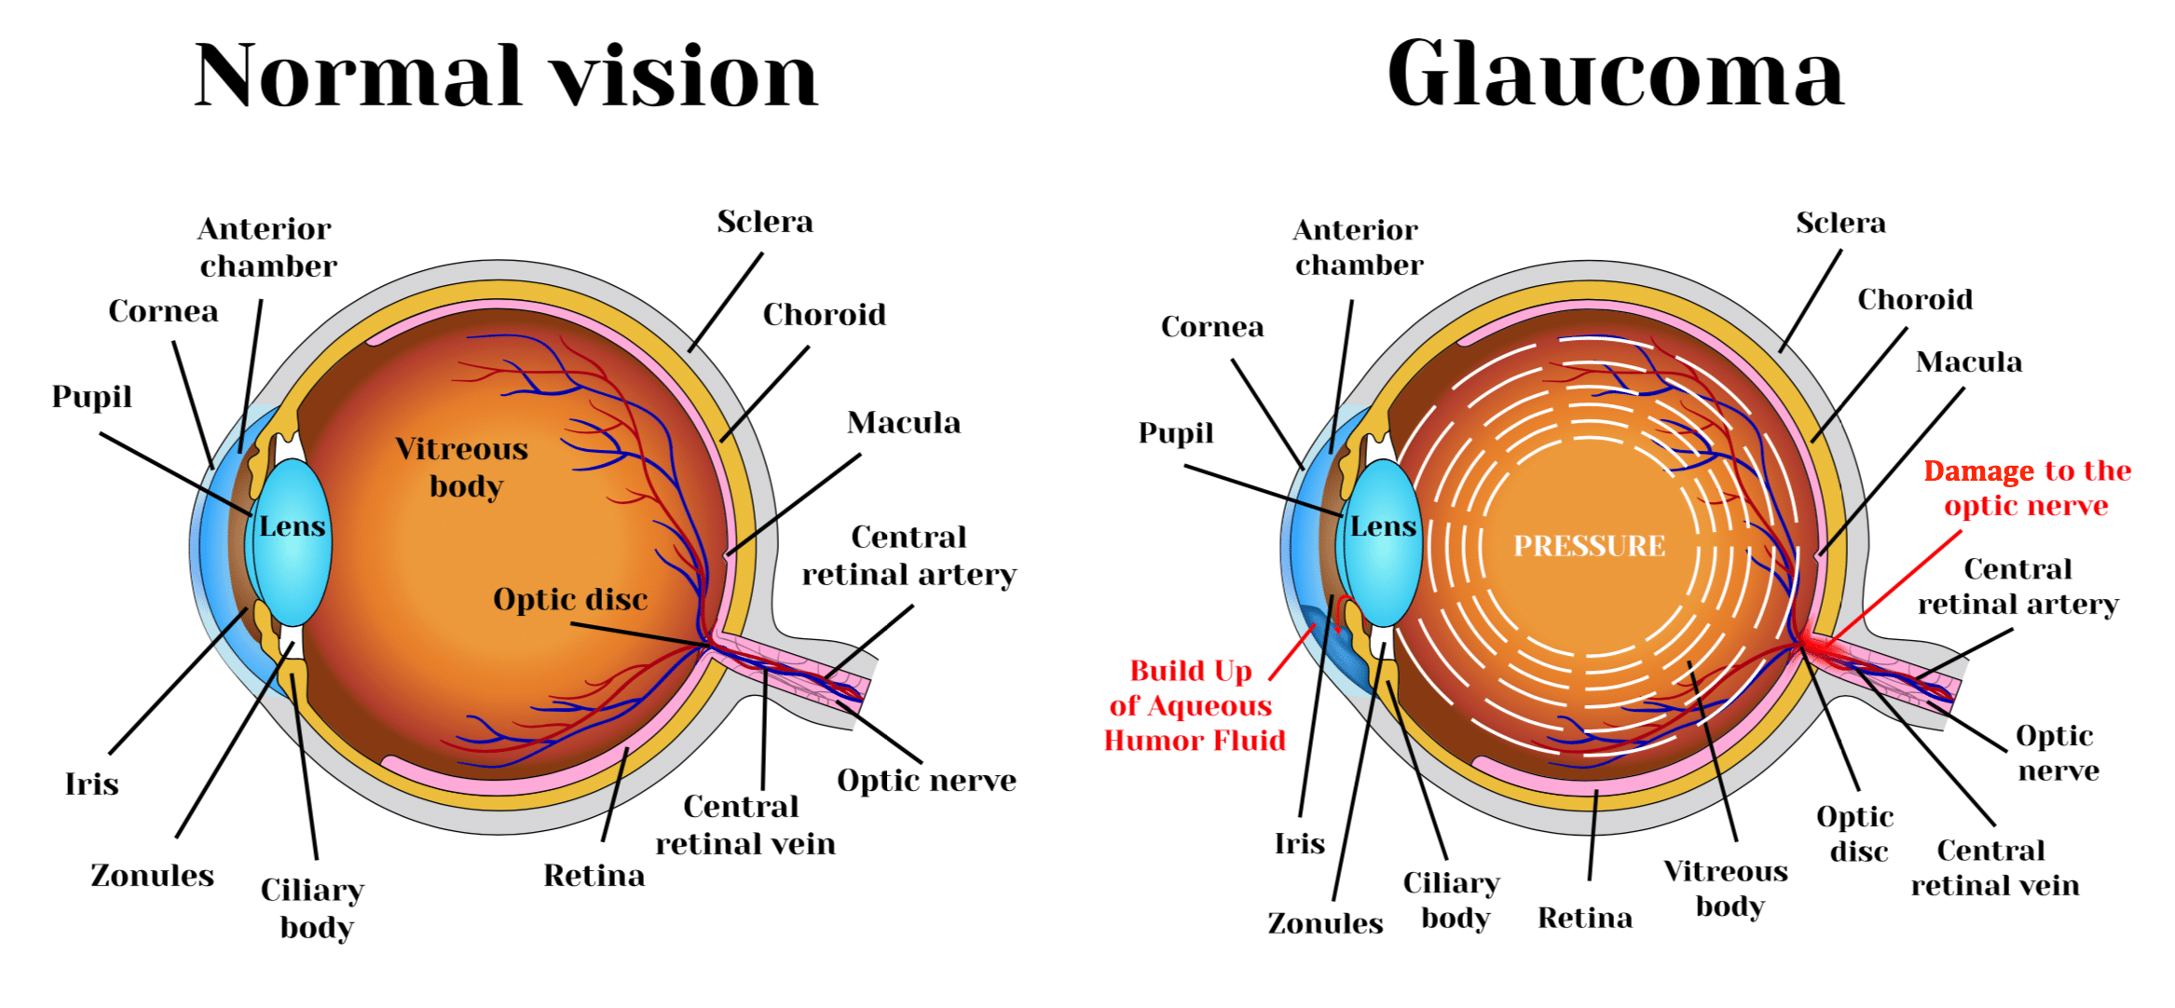
WHAT IS GLAUCOMA?
Glaucoma is a group of eye diseases that can cause vision loss and blindness by damaging a nerve in the back of your eye called the optic nerve. The damage to the optic nerve is caused by increased pressure when fluid builds up as a result of improper drainage or overproduction of fluid. Glaucoma can lead to vision loss if not treated. Vision loss from glaucoma, once it has occurred, is permanent. According to the American Academy of Ophthalmology, glaucoma is the leading cause of blindness in adults aged 60 and older.

Slide 4
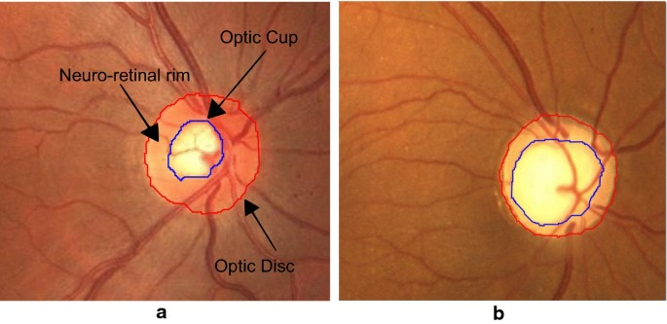
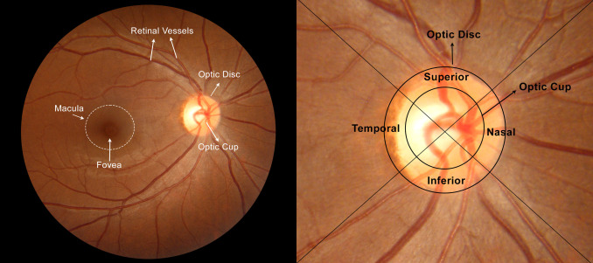
GLAUCOMA SCREENING IN FUNDUS IMAGES
c
Normal optic nerve head
Glaucoma Cupping
Demonstration of Optic Cup and Optic Disc

Slide 5
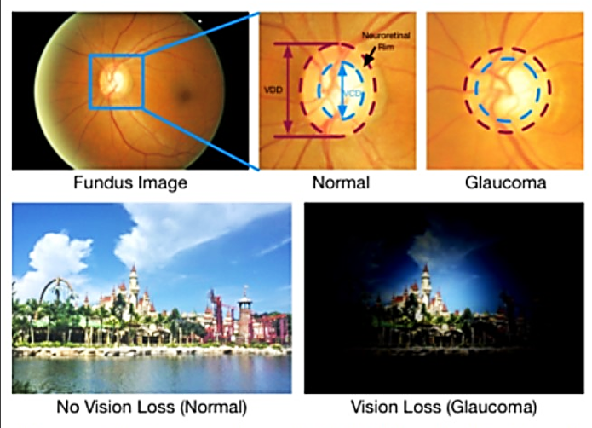
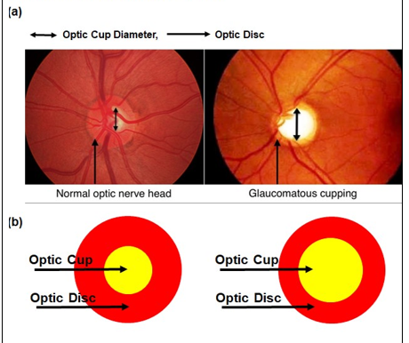
Glaucoma Screening
Glaucoma is the second leading cause of blindness in the world behind cataracts, but, unlike cataracts, the vision loss associated with glaucoma is largely irreversible. One major glaucoma screening technique is optic nerve head (ONH) assessment.

Slide 6
Literature Survey
Automated Glaucoma Detection:
A ReviewAuthors: Wong et al. (2019)
This comprehensive review highlights the evolution of automated techniques for glaucoma detection, with a focus on image-based approaches. The authors discuss the significance of early diagnosis, the challenges posed by the disease, and the emergence of deep learning as a powerful tool for analyzing retina fundus images.
Glaucoma Diagnosis Using Deep Learning Techniques:
A ReviewAuthors: Ting et al. (2021)
The paper reviews recent advancements in using deep learning techniques for glaucoma diagnosis. It covers various aspects, including image preprocessing, feature extraction, and model architectures. The authors discuss the strengths and limitations of different approaches and highlight the potential impact of AI on improving glaucoma detection accuracy.

Slide 7
Literature Survey
Transfer Learning in Retinal Image Analysis:
A Systematic ReviewAuthors: Gulshan et al. (2016)
Focusing on transfer learning, this systematic review explores its applications in retinal image analysis. Transfer learning has been increasingly utilized in glaucoma prediction models to leverage knowledge gained from large datasets in related tasks, improving the generalization of models to new datasets.
Evaluation Metrics in Glaucoma Detection From Fundus Images:
A SurveyAuthors: Akram et al. (2018)
This survey focuses on the evaluation metrics used in assessing the performance of glaucoma detection algorithms. The paper discusses the challenges associated with benchmarking and compares various metrics, shedding light on the complexities of measuring the efficacy of different models.

Slide 8
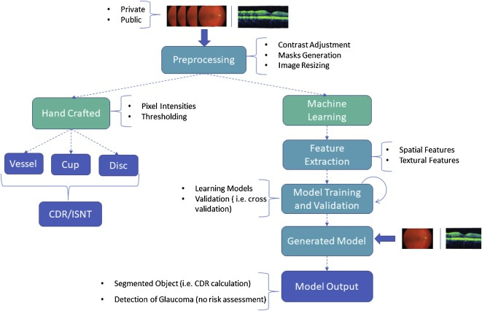
Methodology

Slide 9
Methodology
Use case:
Classifying retinal fundus images as glaucoma or nonglaucoma (normal).
Training a model to classify retinal fundus images from a dataset of labelled images.
CSV file provides file names, CDR (cut to disk ratio) and classification of Glaucoma negative(a) or positive(b).
If CDR ≥ 0.65, the image is Glaucoma positive.
If CDR <0.65, the image is Glaucoma negative.

Slide 10
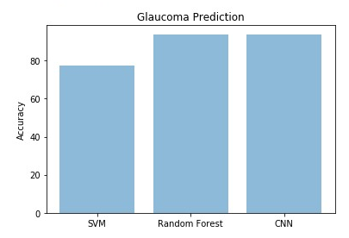
Experiments & Results
Shuffled the dataset (650 jpeg images in total, 196 Mb) and split into
-Training (80% of images, 520 images of which 134 Glaucoma positive and 386 Glaucoma negative)
- Validation (20% of image, 130 images of which 34 Glaucoma positive and 96 Glaucoma negative).
Best results with deep learning model - Convolutional Neural Network (CNN) in Keras, TensorFlow.
- Batch size: 64
- Number of Epochs: 20
- Architecture: Convolution layers followed by dense layers
- Optimizer: Adam
- Test loss: sparse categorical crossentropy 2.0893890133e-05
- Accuracy on test data: 93.83%
We tried 2 machine learning models:
- SVM (support vector machine), accuracy on test data: 71.53%
- Random Forest, accuracy on test data: 93.50%

Slide 11
Conclusion
In conclusion, the utilization of artificial intelligence (AI) for predicting the occurrence of glaucoma from retina fundus images represents a significant stride towards revolutionizing the diagnosis and management of this debilitating eye disease. The outcomes and implications derived from this research underscore the transformative potential of AI in ophthalmology.
The development and implementation of deep learning models trained on diverse and well-curated datasets demonstrate the feasibility of leveraging AI for early glaucoma detection. The ability of these models to discern subtle changes in retina fundus images, indicative of early-stage glaucoma, holds promise for enhancing the accuracy and efficiency of diagnostic processes.

Slide 12
References
[1] Breiman, Leo. ”Random forests.” Machine learning 45 (2001): 5-32.
[2] "Artificial intelligence in glaucoma: opportunities, challenges, and future directions" by Singh, O. P., et al. (2023). https://pubmed.ncbi.nlm.nih.gov/38102597/
[3] "Clinical Utility of Artificial Intelligence in Glaucoma Care" by Lipton, I., et al. (2020). https://www.ncbi.nlm.nih.gov/pmc/articles/PMC10239633/
[4] "Automated Glaucoma Screening and Diagnosis Based on Retinal Fundus Images Using Deep Learning Approaches: A Comprehensive Review" by Yu, K., et al. (2022). https://www.mdpi.com/2075-4418/13/13/2180
[5] "Explainable AI for Glaucoma Diagnosis and Prognosis: A Review" by Yu, L., et al. (2023). https://ieeexplore.ieee.org/document/9766027/
[6] "The potential of artificial intelligence in glaucoma care" by McNaughton, C., et al. (2019). https://www.ncbi.nlm.nih.gov/pmc/articles/PMC10239633/
[7] Artificial intelligence for early detection of glaucoma: https://www.nih.gov/news-events/news-releases/nih-study-shows-how-genes-retina-get-regulated-during-development

